Slide 1
Python Lab 1
CSE205

Slide 2
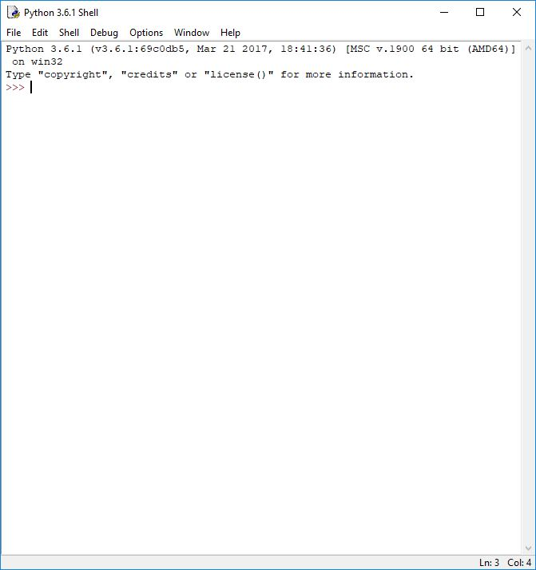
Python IDE
One Python IDE (there are many) is called Idle
At the start menu, search for Idle and run it, like this:

Slide 3
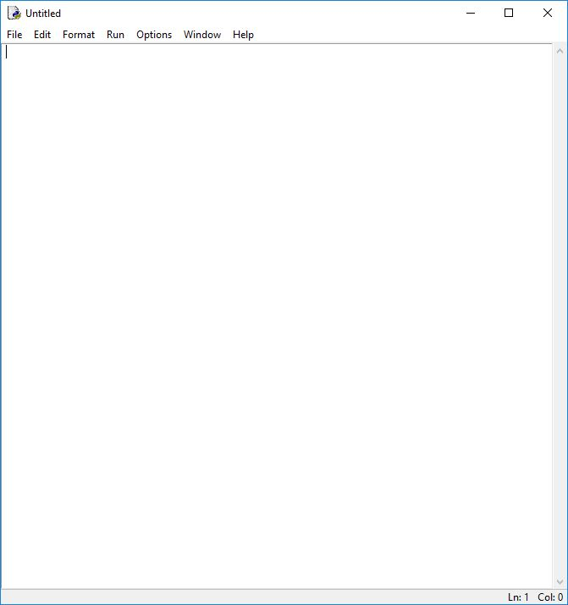
Creating a script
Now create a new script by clicking
File->New File
This should open a new window like this:

Slide 4
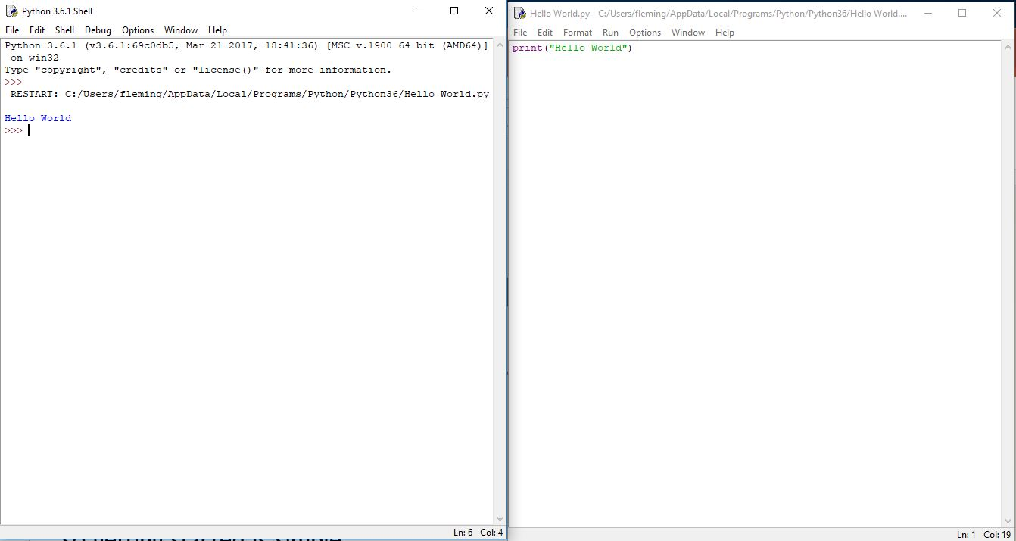
Interpreted vs compiled
Python is an interpreted language, unlike Java
Python has much less overhead that Java, so getting started is simple
For example, Hello World in Python is just one line.
Try this for yourself. Click Run->Run Module to run your program, or F5

Slide 5
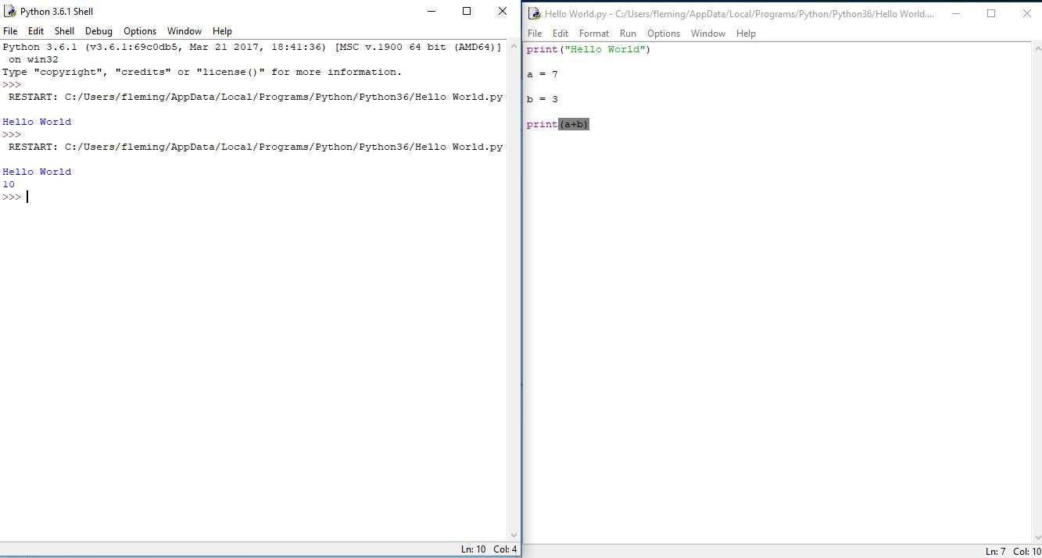
Variables
Variables in Python don’t need to be declared.
Type is inferred from how you use them
Try this out:

Slide 6
Conditionals
Conditionals in Python look a little different than in Java, but they work the same.
Try this code:
Notice there are no {}. Python uses indentation to denote blocks
Don’t mix tabs and spaces or it won’t work. Try this out in your code.

Slide 7
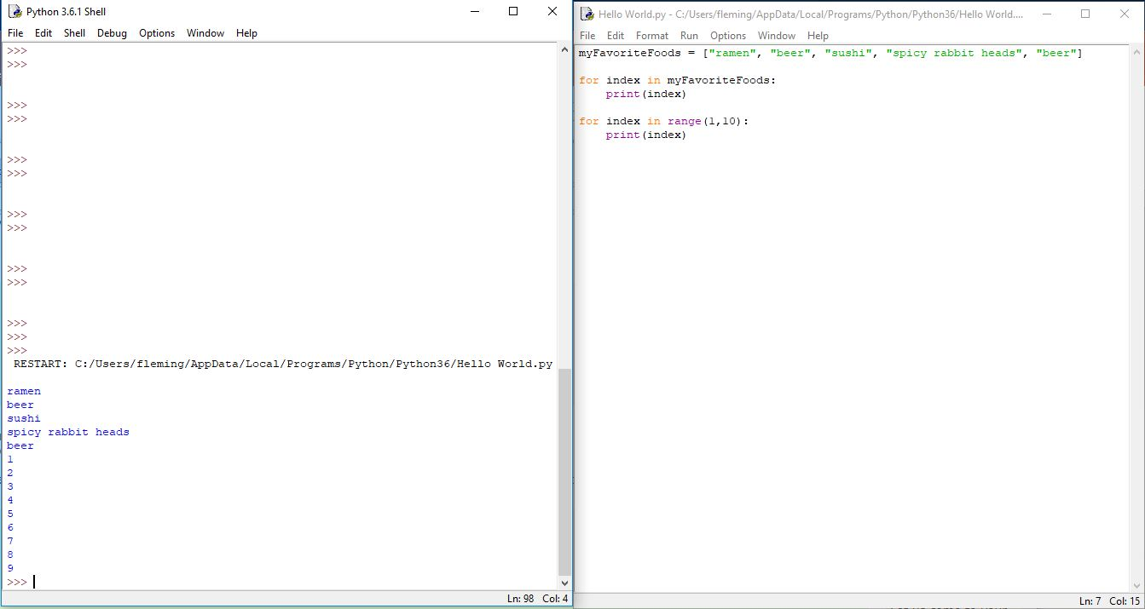
Loops
For loops in Python are designed to loop over lists.
This looks a little different that Java.
To loop over numbers, you have to make a list of number using the range() function.
Try this code:

Slide 8
Assignment 1
Your first lab assignment is to use these basic constructs to write a short program that computes N! (Remember this is N*(N-1)*(N-2)…*1)
Use loops, not math.factorial()
If the result is even, print “Yay, even”.
If it’s odd, print “Boo, odd”.
You don’t need to write a function, just a simple script. Use a variable for N and your TA will tell you what N to use.
When you’re done, demonstrate your working program to the TA.
***Note: this is an individual assignment. You cannot receive help from other students, only your TA.

